Slide 1
Principles of Autonomy and Decision Making
TANVIR TANJUM SHOURAV
00170500
22/07/2025

Slide 2
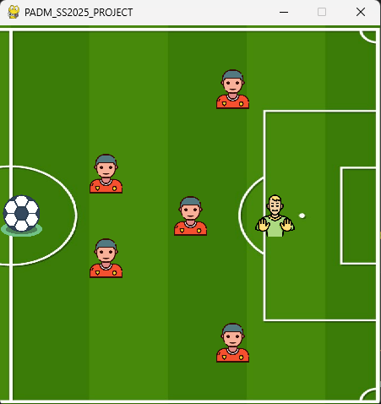
PADM – Project
Concept
A football game where the ball needs to reach the goalpost by dribbling over defenders and the goalkeeper.

Slide 3
PADM – Project
Objectives, Solving Approach & Tools
Objectives:
Player need to put the ball (agent) inside goalpost.
Player need to dribble past defenders and the goalkeeper.
Player need to score as soon as possible and using less stamina (shortest path)
Approach:
Q-Learning (with ε-greedy and decay)
Tools:
Python
Gymnasium
Pygame
Numpy
Seaborn
Matplotlib

Slide 4
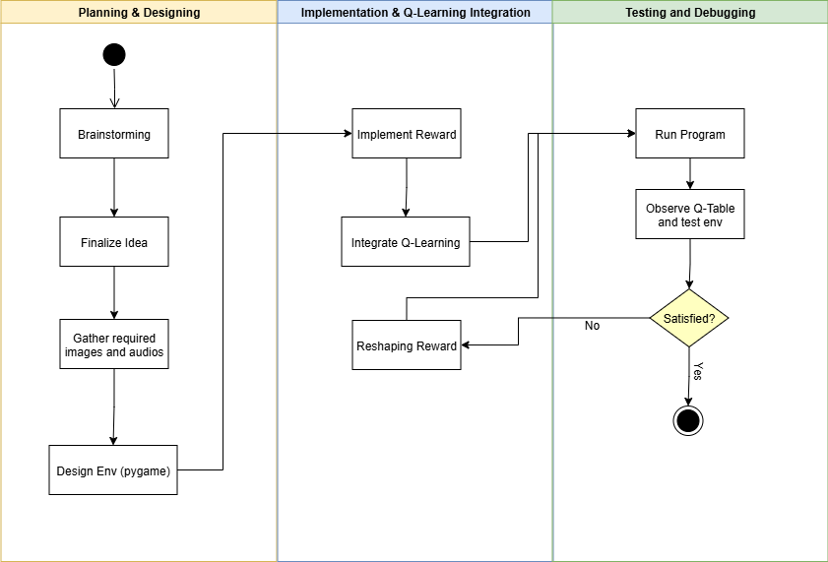
PADM – Project
Workflow

Slide 5
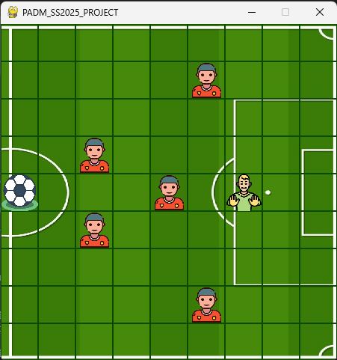
Environment Overview
Custom Gymnasium Environment
0
1
2
3
4
5
6
7
8
9x9 grid-based 2D environment
Agent: Ball, initial position (4, 0)
Goal: Goalpost [(3, 8), (4, 8), (5, 8)]
Obstacles/Hell-states:
Defenders: 5 [(3, 2), (5, 2), (1, 5), (4, 4), (7, 5)]
Goalkeeper: 1 (4, 6)
Actions: 0 – Up
1 – Down
2 – Right
3 – Left
0 | 1 | 2 | 3 | 4 | 5 | 6 | 7 | 8

Slide 6
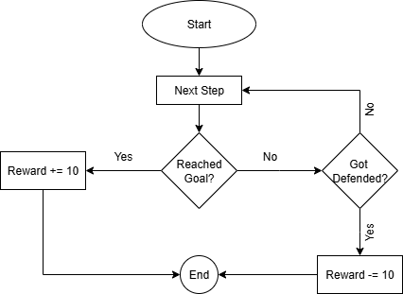
Environment Overview
Reward Structure (Initial) & Flowchart
Initial Reward Structure:
Reward = 0
Player reaches goal:
Reward += 10
Player got defended by defender/goalkeeper:
Reward -= 10

Slide 7
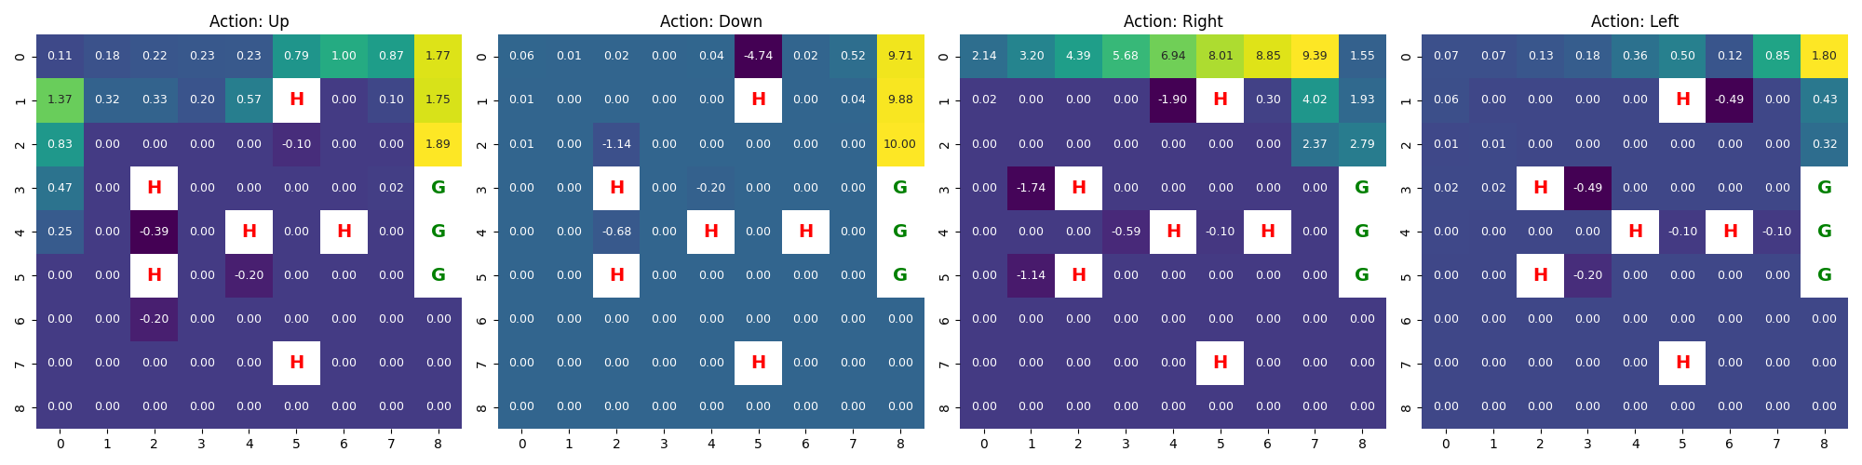
Environment Overview
Reward Structure (Initial) – Q-Table
Q-table:

Slide 8
Environment Overview
Reward Structure (Initial) – Video

Slide 9


Environment Overview
Reward Structure (Initial) – Observation
Check | Task
 | Scored Goal
 | Dribble past defenders and goalkeeper
 | Preserved stamina by taking shortest path

Slide 10
Environment Overview
Reward Structure (Reshaped - Final)
Final Reward Structure:
Reward = 0
Step = 0
For each step:
Calculate Old Distance from Goal
Step++
Calculate New Distance from Goal
Old Distance > New Distance:
bonus = 0.1
Old Distance < New Distance:
bonus = -0.2
Old Distance == New Distance:
bonus = 0
Player reaches goal:
Reward += 10 - (Step/ 100)
Player got defended by defender/goalkeeper:
Reward = abs(Reward) * (-1) - 10 - (Step / 100)
Otherwise:
Reward += bonus - (Step / 100)

Slide 11
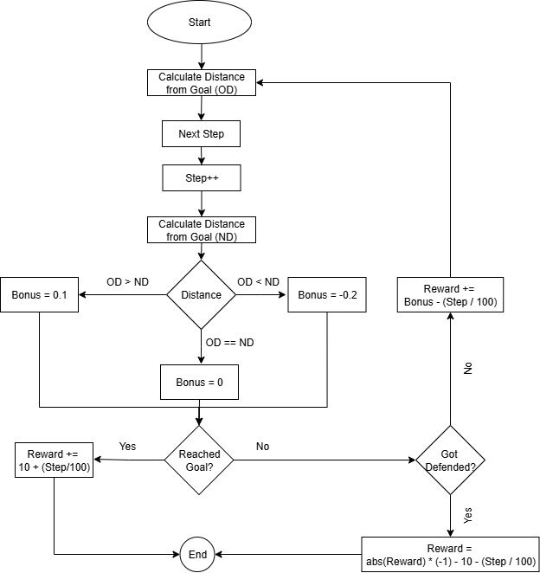
Environment Overview
Reward Structure (Reshaped - Final) – Flowchart

Slide 12
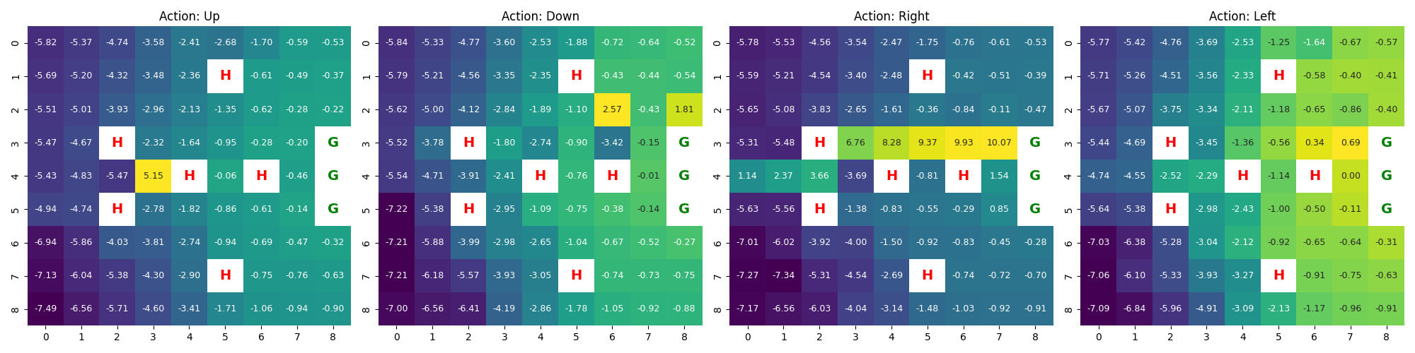
Environment Overview
Reward Structure (Reshaped - Final) – Q-Table
Q-table:

Slide 13
Environment Overview
Reward Structure (Reshaped - Final) – Video

Slide 14
Environment Overview
Reward Structure (Reshaped - Final) – Observation
Check | Task
 | Scored Goal
 | Dribble past defenders and goalkeeper
 | Preserved stamina by taking shortest path

Slide 15
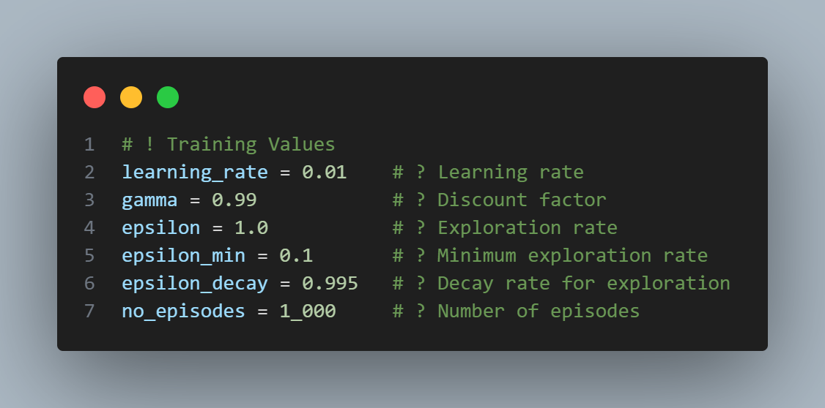
Q-Learning
Pseudocode
Initialize Q-table Q(s, a) arbitrarily (e.g., zeros)
Set learning rate α ∈ (0, 1)
Set discount factor γ ∈ (0, 1)
Set initial exploration rate ε = 1.0
Set minimum ε (ε_min), e.g., 0.1
Set decay rate for ε (ε_decay), e.g., 0.995
For each episode:
Initialize state s
Repeat until s is terminal:
With probability ε:
Choose a random action a
Otherwise:
Choose action a = argmax(Q[s, a]) # Exploitation
Take action a, observe reward r and next state s'
Q[s, a] = Q[s, a] + α * (r + γ * max(Q[s', a']) - Q[s, a])
Set s = s'
After episode:
ε = max(ε_min, ε * ε_decay) # Decay ε but don’t go below ε_min
End

Slide 16
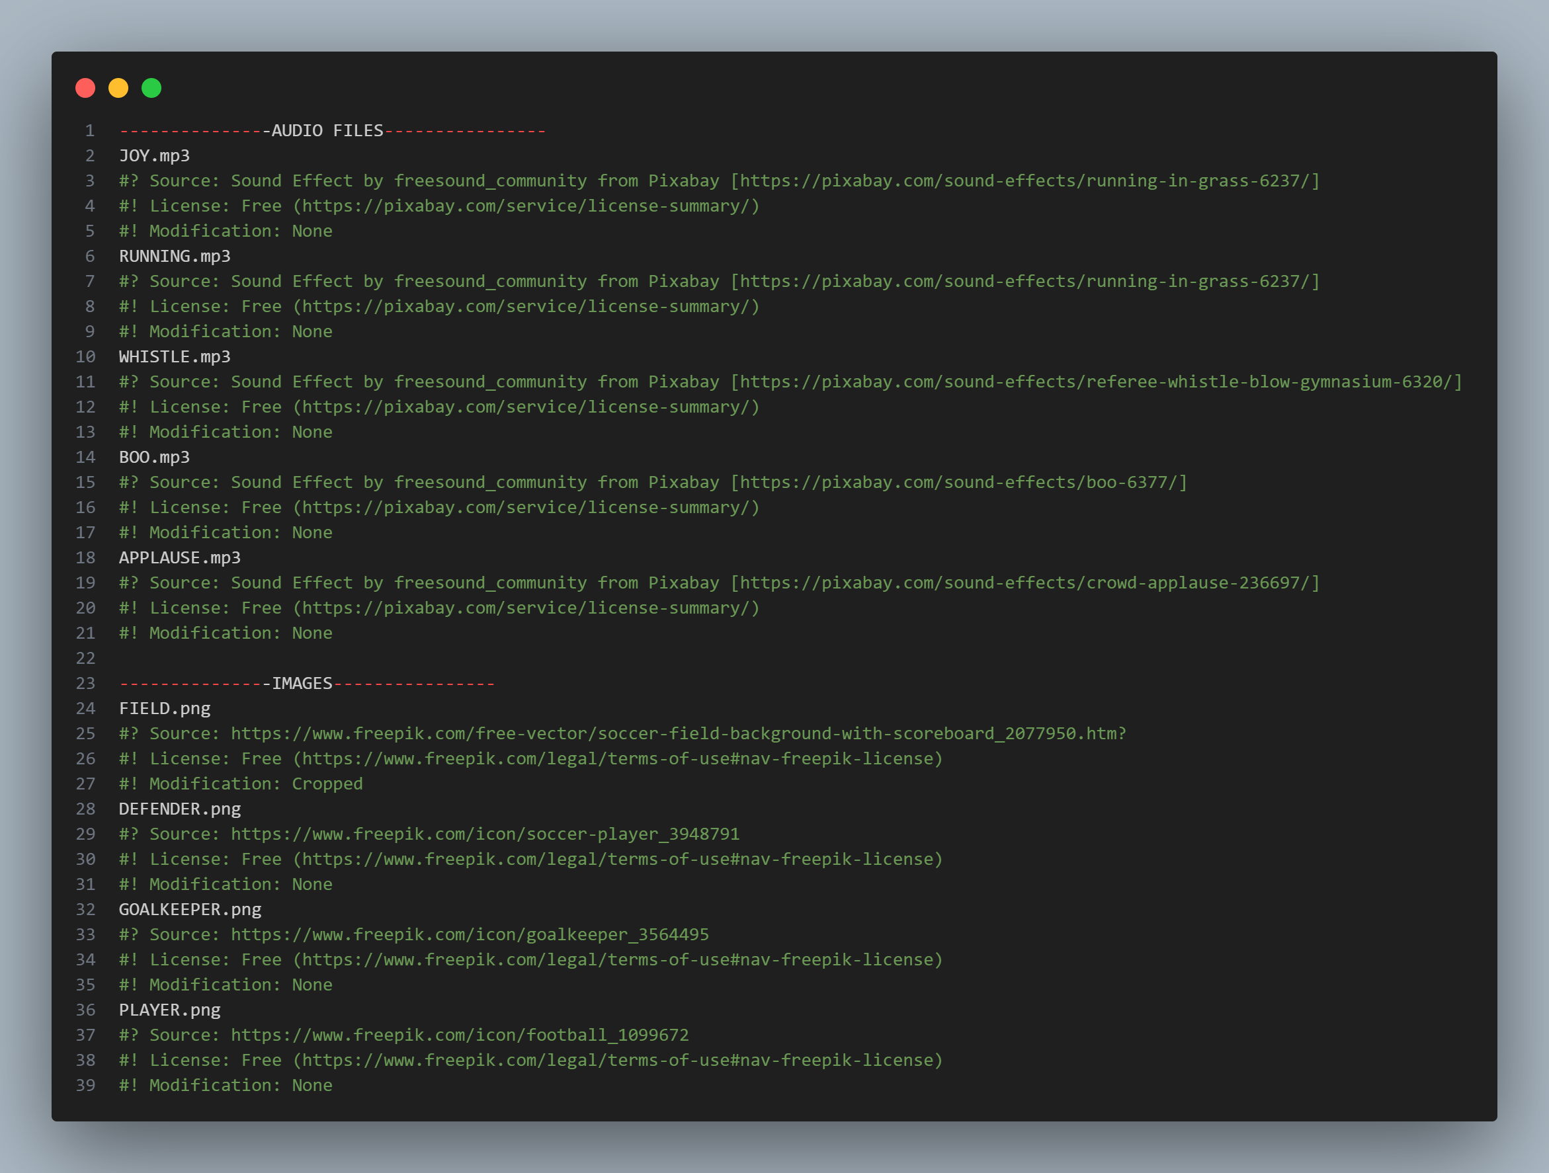
Reference and Links
Picture and Audio Reference
Source Code
https://github.com/tanvirtanjum/THI_SS2025_PADM_PROJECT.git

Slide 17
Thank you

